Slide 1

Flight Delay Analysis
Kashish Kothari (202118011) Jainam Shah (202118014)
Dhvani Golani (202118020) Prachi (202118021)

Slide 2
Aim of the Project:
Every year, a ton of flights get postponed which includes some expense both for the airline and the traveler in various ways. There could be a few reasons which are unavoidable, for example, weather patterns, air traffic or any unexpected occasion; however likewise there could be a few reasons which can be managed by working on the cycle.
In this project, we aim to analyze and visualize the data which contains flight details and find out the reason behind their delay and cancellation.
Our vision is to study the reason behind these delays and cancellation in order to make the flight experience pleasant.

Slide 3
Dataset Description:
The flight dataset we have worked on revolves around the United States for the year 2015.
It consists of 2,74,964 items and 65 attributes.
Attributes | Description
Route | The route of the flight
Airtime | Time in which the flight was in the air
Airline | Company that provide air transport service
Weather delay | Delay due to weather conditions
Country | Name of country (U.S)
State | Name of State
Longitude | Measures distance east or west of the prime meridian
Latitude | Measurement of distance north or south of the Equator
Calculated Field | Description
originalairportpoint | Using the make point function we are finding the original point from where the flight starts.
makerouteline | Using the makeline function we are creating the route between original airport point and destination airport point.
destisnationairportpoint | Using the makepoint function we are finding the original point where the flight lands.

Slide 4
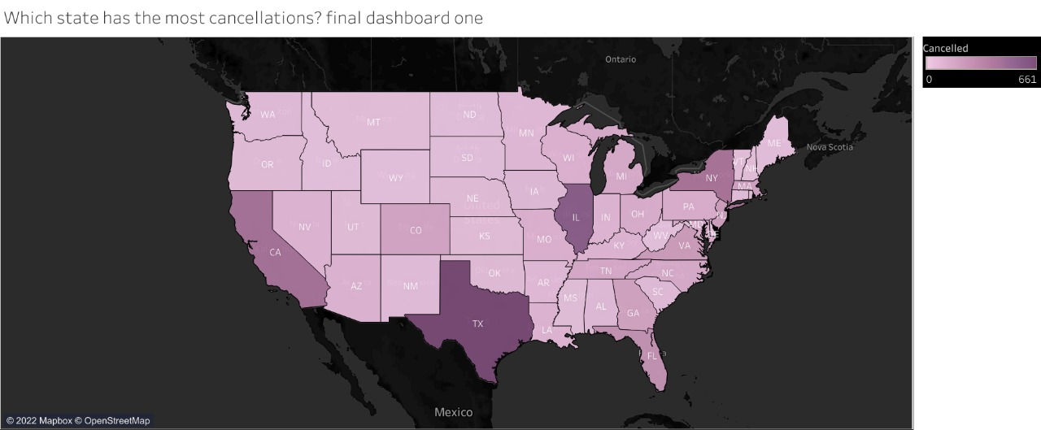
Which State has the most cancellations ?
The most effective way to compare overall statistics from various countries, states, or regions is through choropleth maps. It will be challenging to represent the 56 US States in any other idiom. The total number of cancelled flights in each state is shown on the map clearly. Since this is an interactive map, each state can also be displayed separately.
Inference: Texas has the highest number in cancellation of flights which is 661 followed by Illinois (537) and California (411).

Slide 5
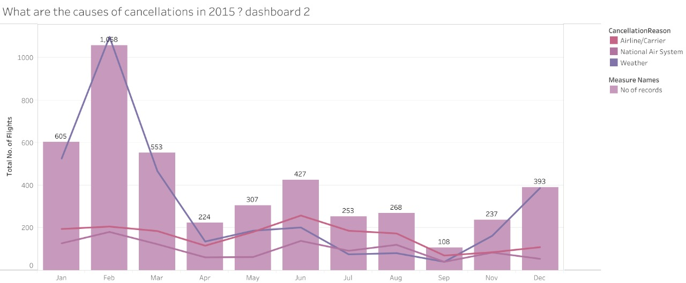
What are the causes of the cancellations in 2015 ?
Combination charts are used to display various mark types in a single visualization. The total number of flights that were travelled in each month is depicted in a bar graph. To show how two or more variables change over the course of a year, we used numerous line graphs. The cancellation reasons are shown in the categories. The three main causes of cancellations are weather, national air systems, and airlines/carriers.
Inference: We note that February has the most flights, while September has the fewest.The month of February saw the most cancellations (782) due to weather and the national air system. The biggest number of cancellations attributed to airlines or carriers occurred in June (184).

Slide 6
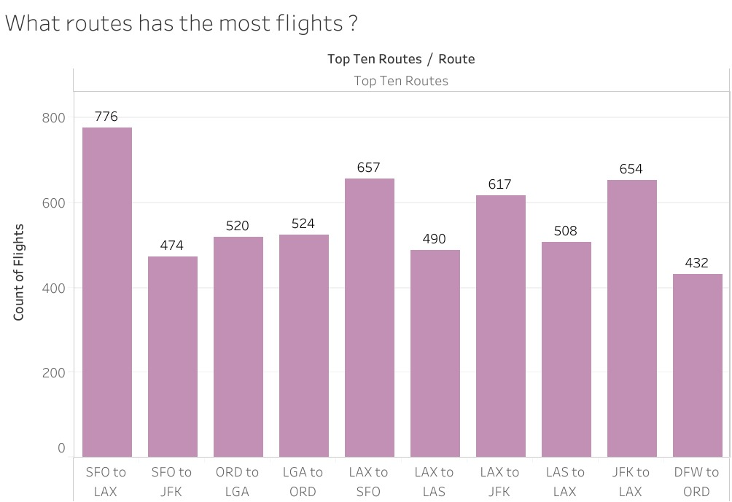
What route has the most flights ?
In bar graphs, the length of the bars that indicate different numerical values are compared. The top ten routes and the overall number of flights between them are shown in the graph.
Inference: We see that the route from SFO to LAX has the most flights (776), and the route from DFW to ORD comes in last with 432 flights annually.

Slide 7
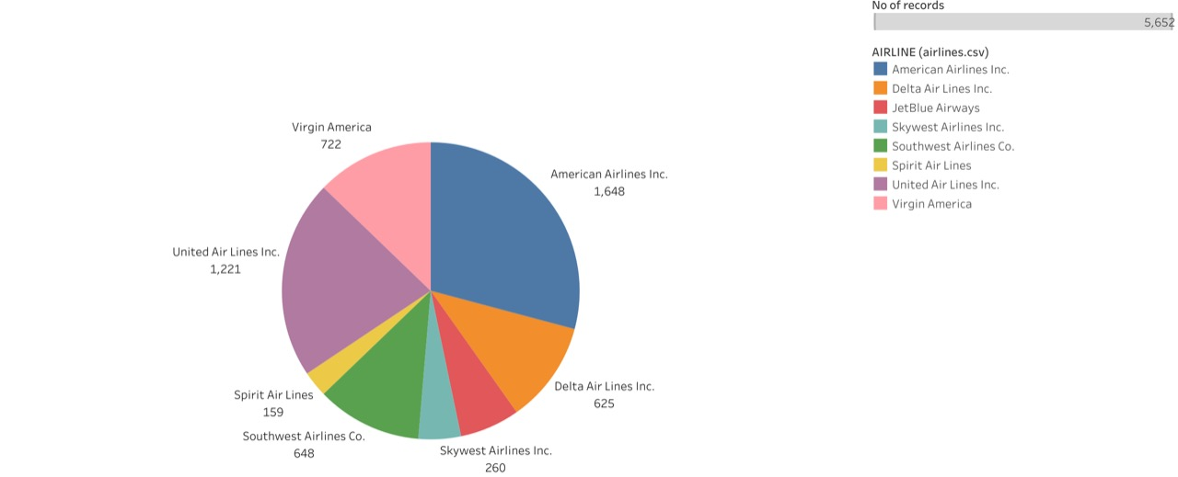
What airlines has the most flights in these busiest routes ?
We can better see the distinct categories that make up the entire circle using a pie chart. The airlines with the most flights on the top 10 routes are represented in this pie chart.
Inference: American Airlines has the most flights (1,648), while Spirit Air lines has the least (159).

Slide 8
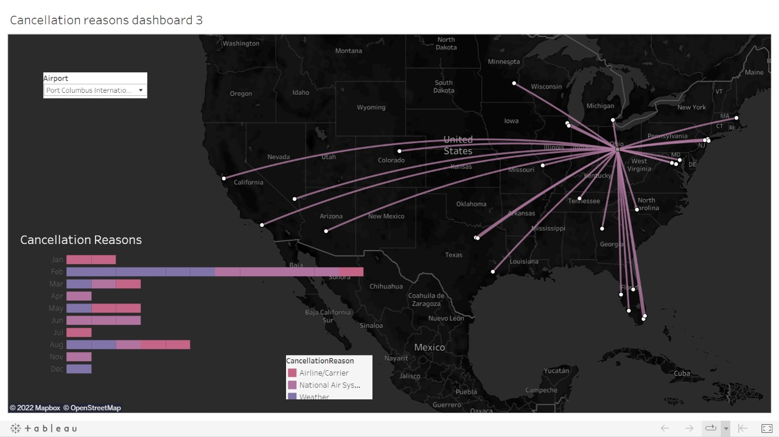
What and how many cancellations does a particular airport receives in 2015 ?
To depict the routes between origins and destinations, spider maps are employed. To display the pathways between Origin Airports and their many Destinations, we have utilized spider maps. Along with this map, there is a stacked bar chart that shows the number of flights cancelled each month along with their cause. Changing the airport will display the routes for that airport and a stacked bar chart for each month, along with the reasons for cancellation, in an interactive graphic.

Slide 9
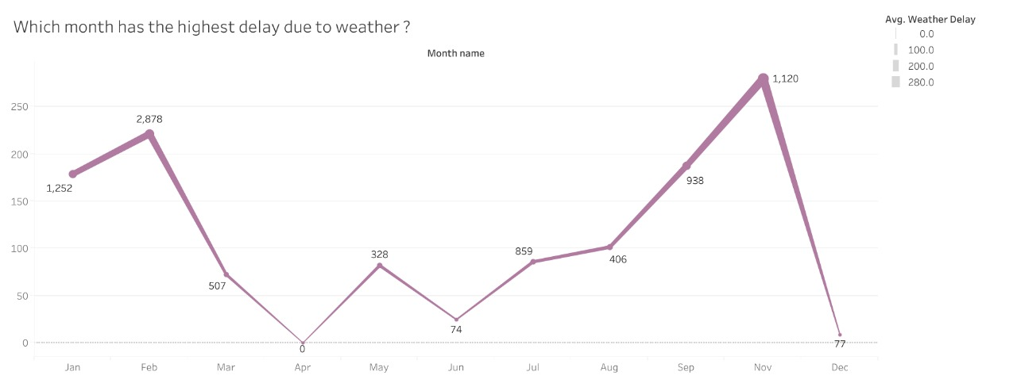
Which month has highest delay due to weather ?
Each data point in a view is connected by a line chart. They aid in the representation of data over time as well. The average delay caused by weather is shown on this line graph for each month.
Inference: We note that there was no delay in April and that the biggest delay (1,120) occurred in the month of November.

Slide 10
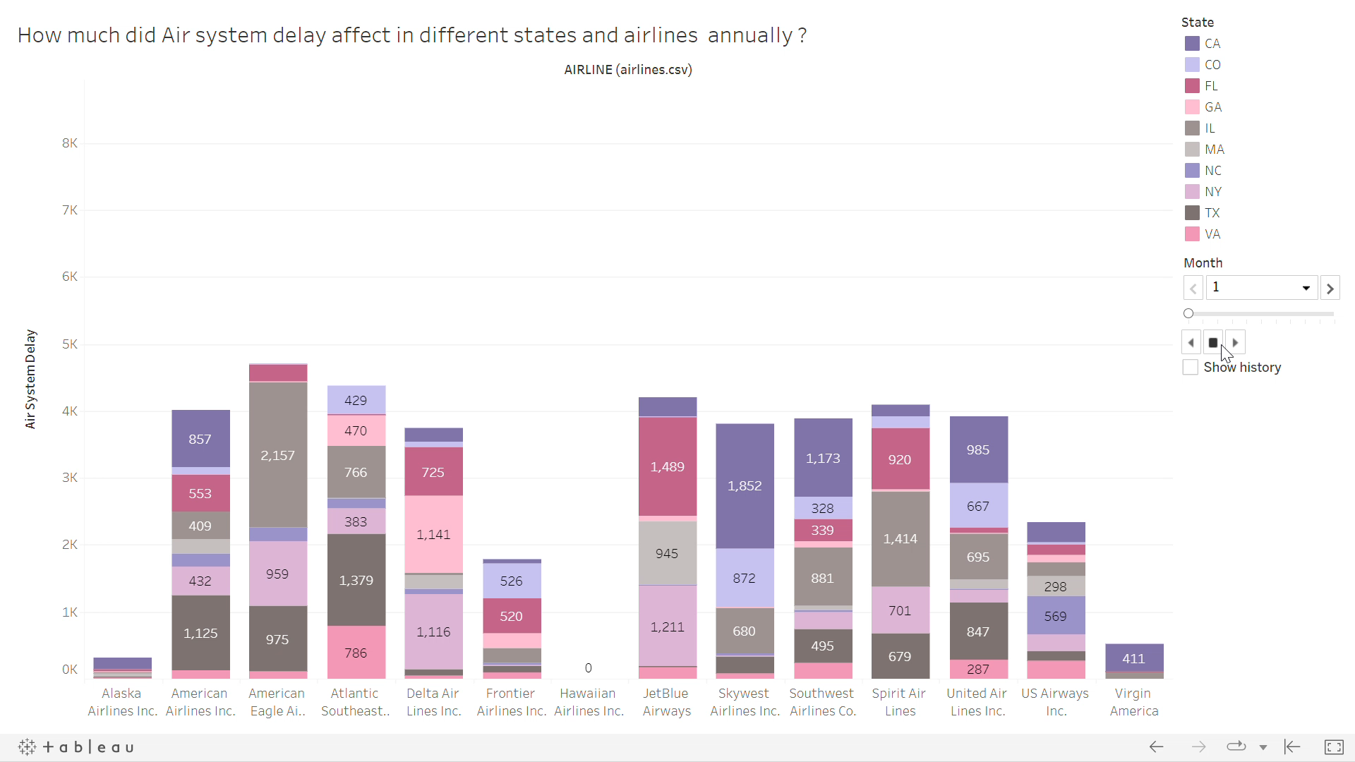
Animations draw attention to shifting patterns in our data, make spikes and outliers obvious, and show us general trends over time. This animation depicts the air system delay for the top ten US states over a 12-month period for various airlines. The categories in this animation's stacked bar graph correspond to the US states. This animation shows the delays caused by the air system for each state and airline.

Slide 11
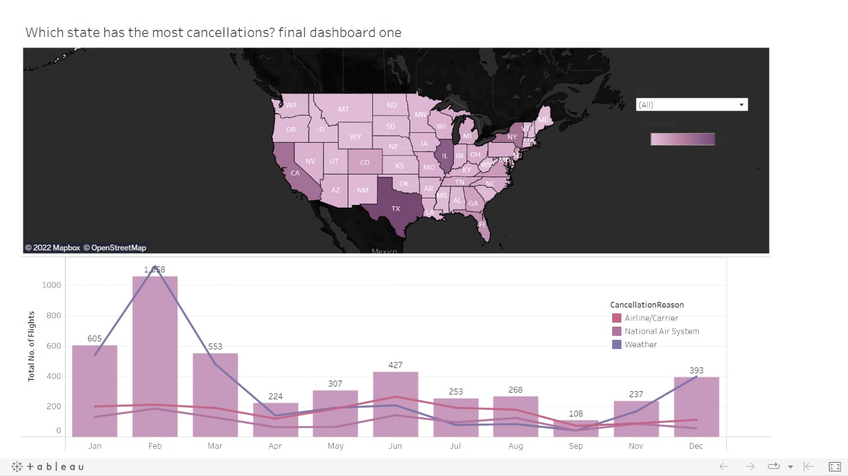
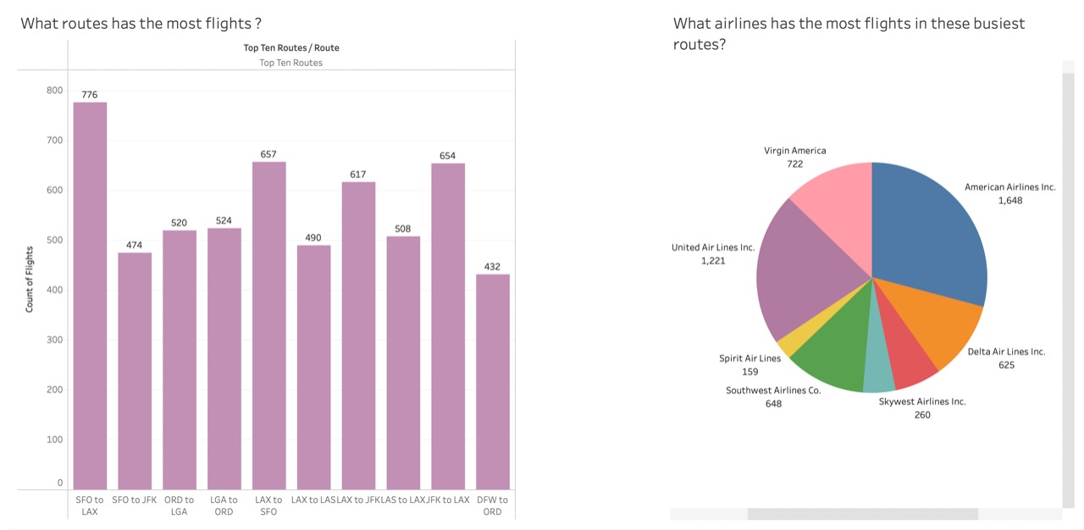
Dashboards :

